Slide 1
FASHION AND HISTORY OF
Italian and French brands
Elizabeth Makhova Form 7 “G”
Grammar school №36

Slide 2
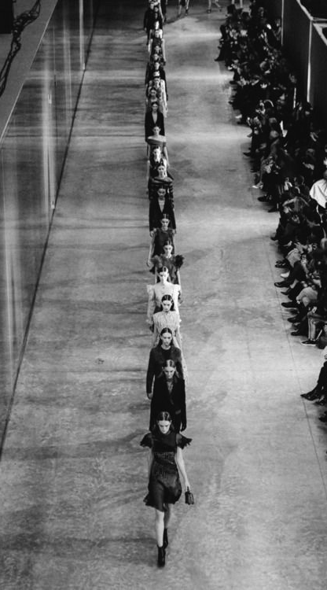
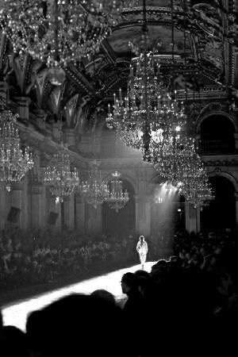
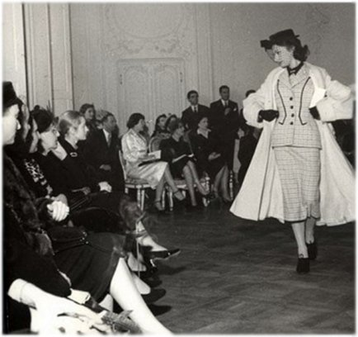
FASHION AND HISTORY OF
,
.
Italian and French brands
Chanel couture house
1910
fashion show in Milan

Slide 3
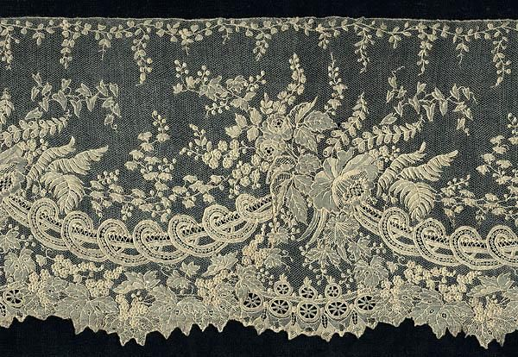
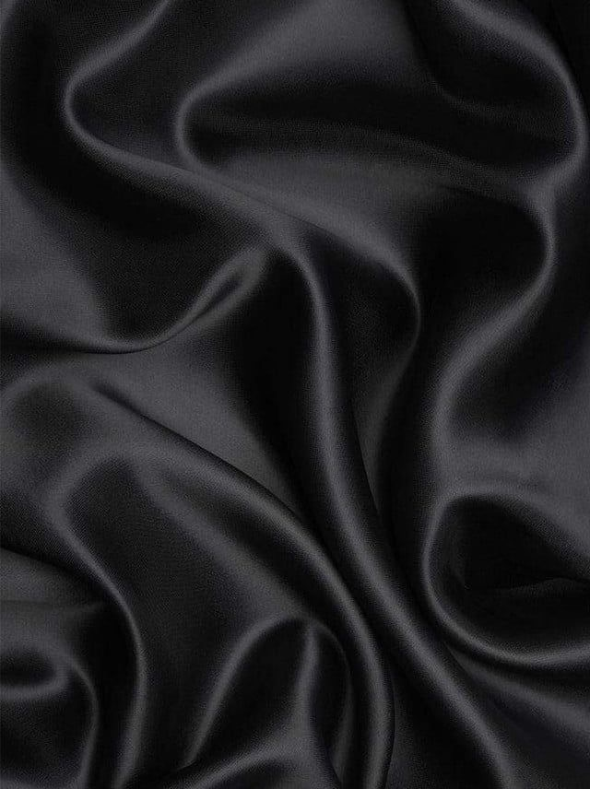
France:Louis XIV.
The first European concept of fashion originated in France in the time of Louis XIV.
Wide production of silk and lace

Slide 4
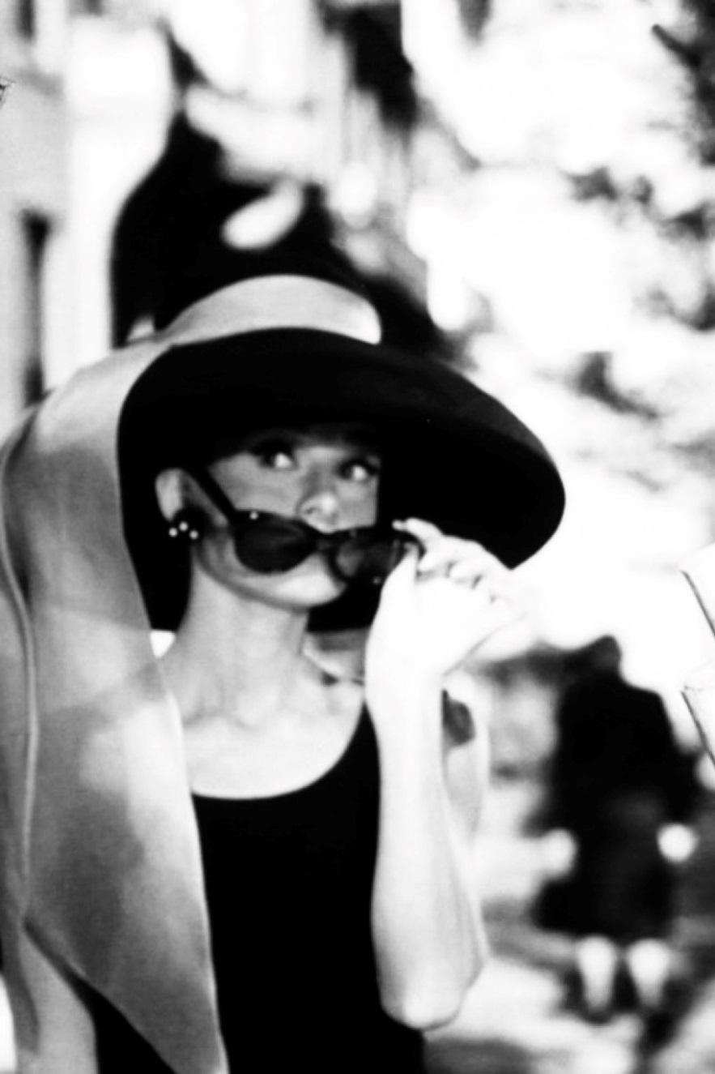
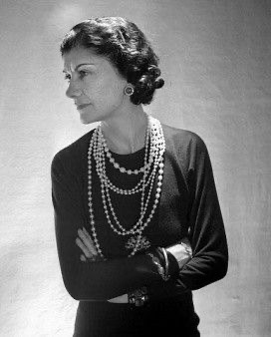
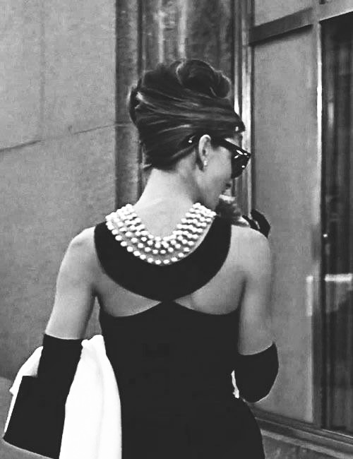
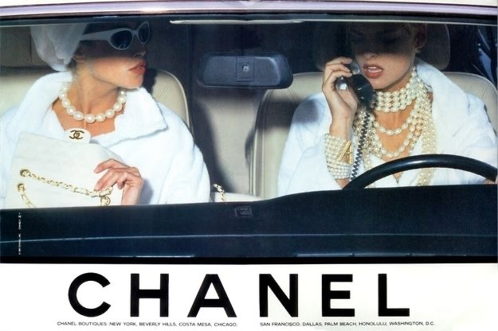
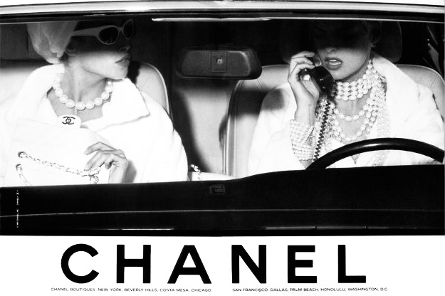
Coco Chanel
Little black dress
1920-1960s
Elegant
Ladies
Hats
,
Pearl

Slide 5
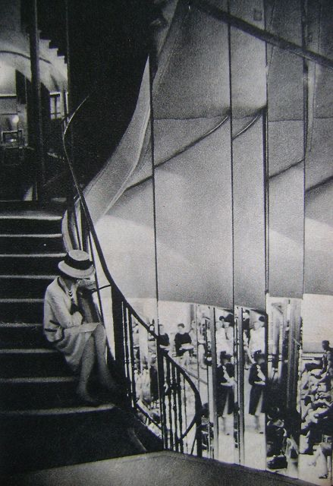
— Coco Chanel

Slide 6
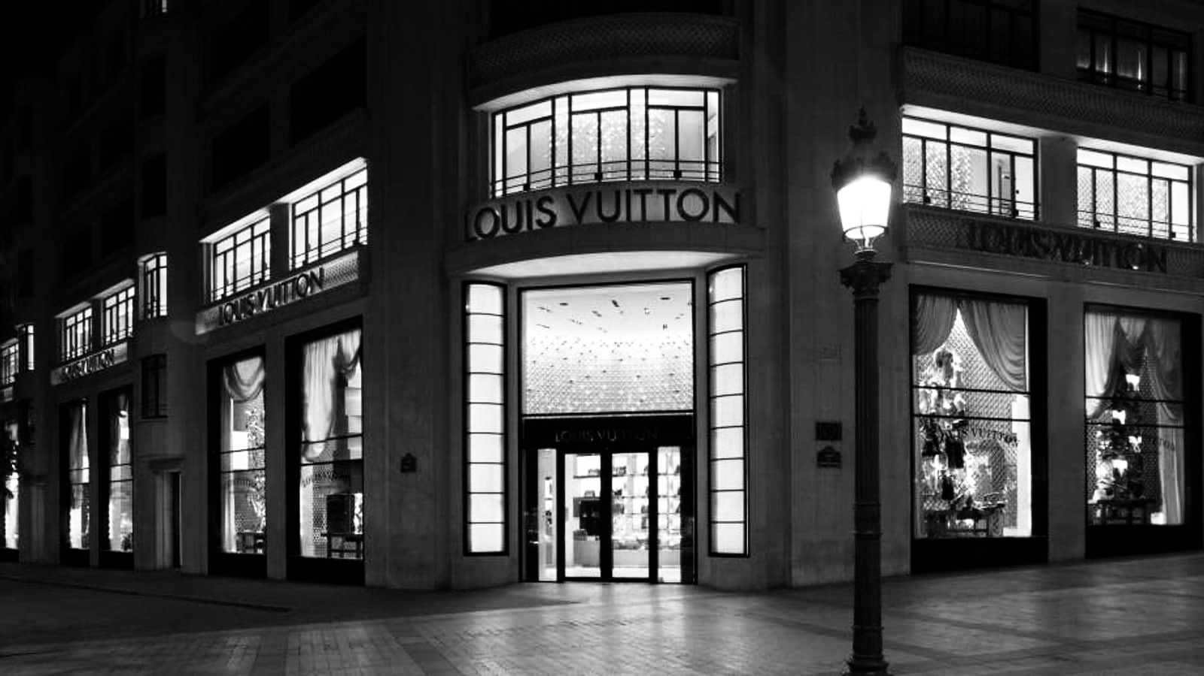
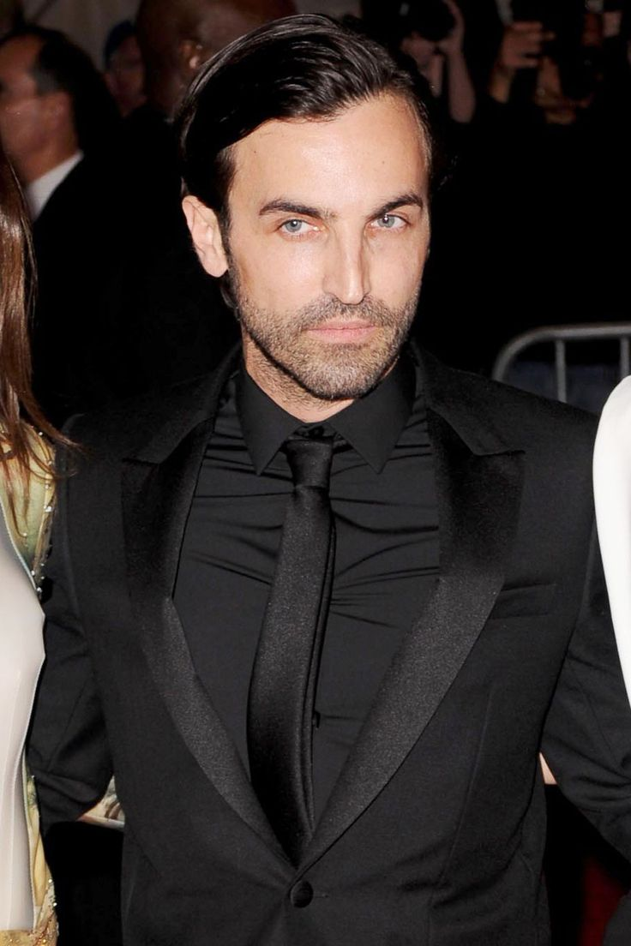
Nicolas Guesquere

Slide 7
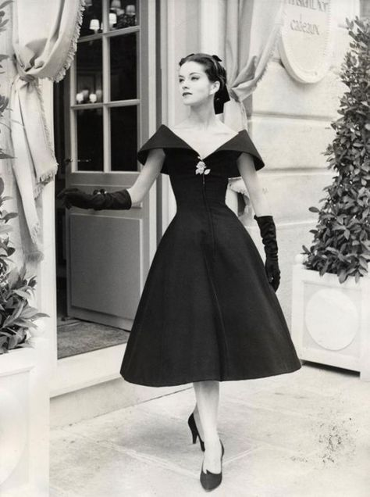
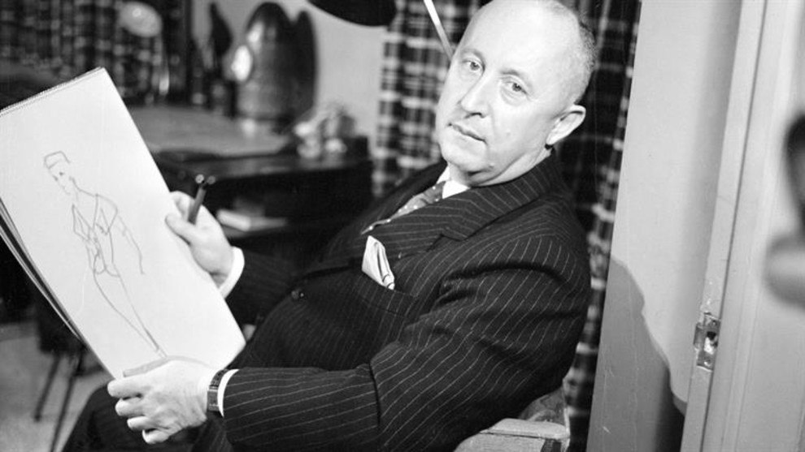
Christian Dior
.
New look dress

Slide 8
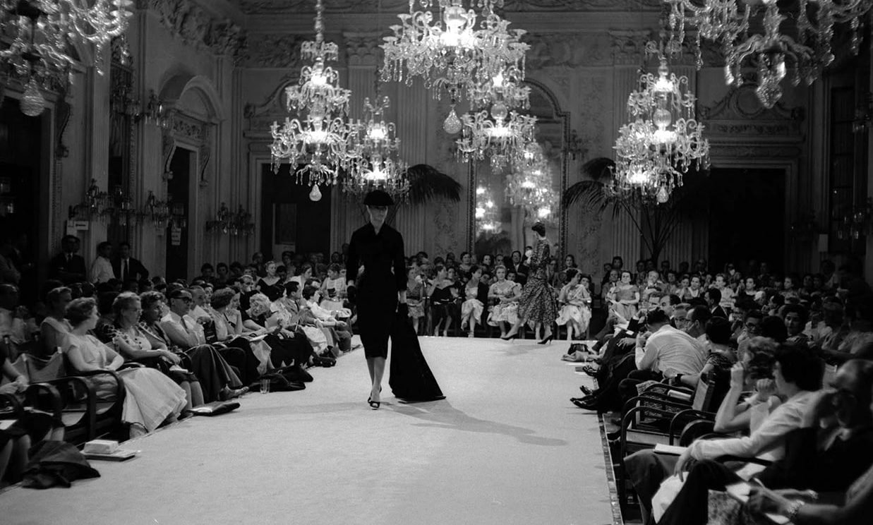
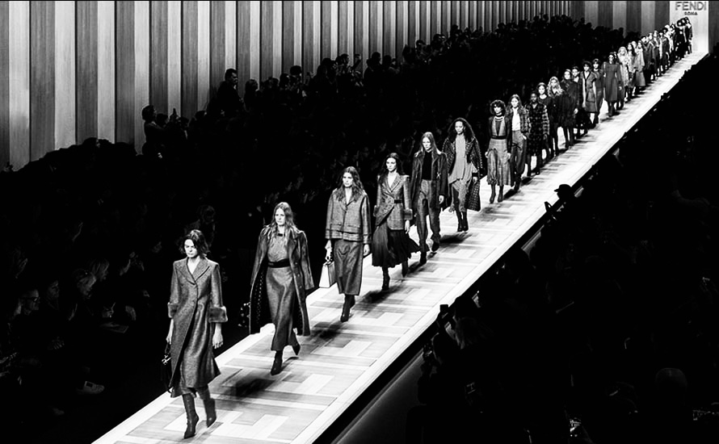
FASHION WEEKS IN MILAN 1959

Slide 9
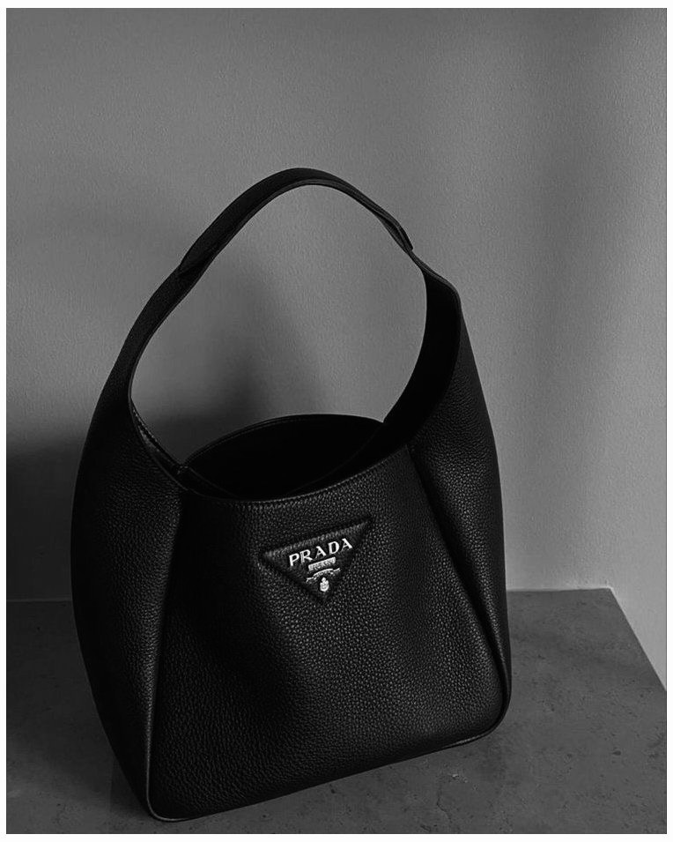
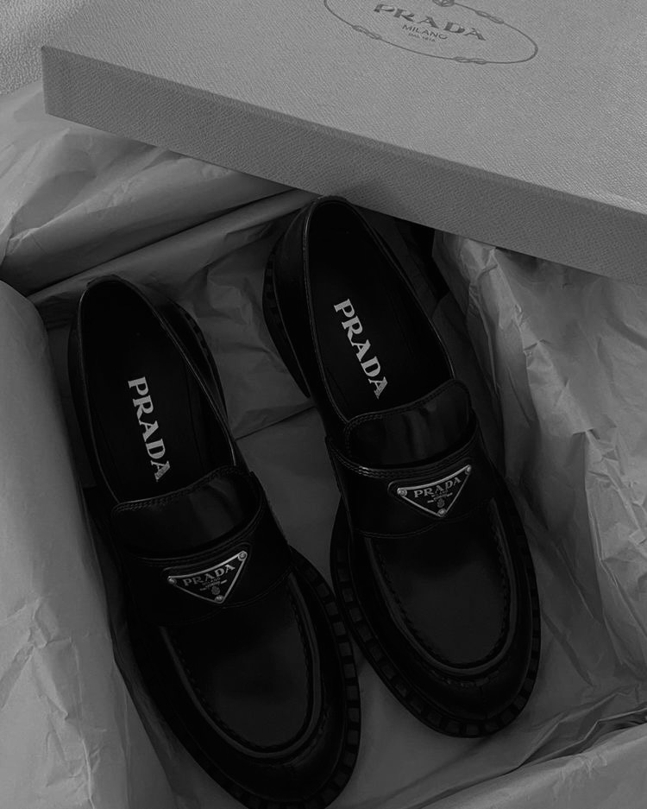
PRADA

Slide 10
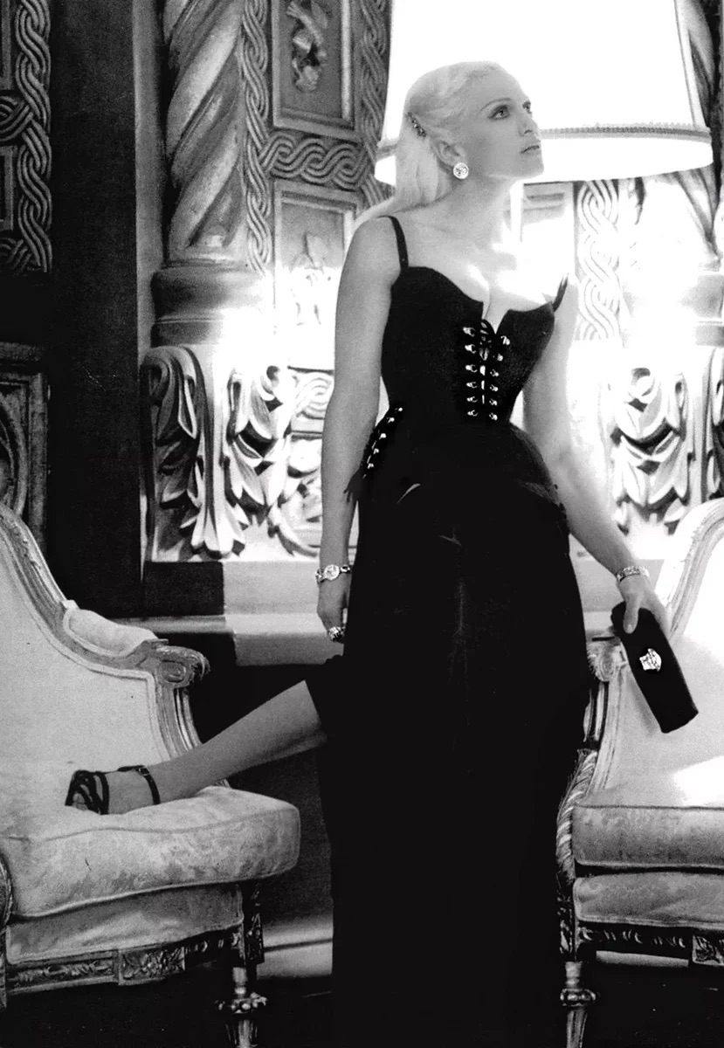
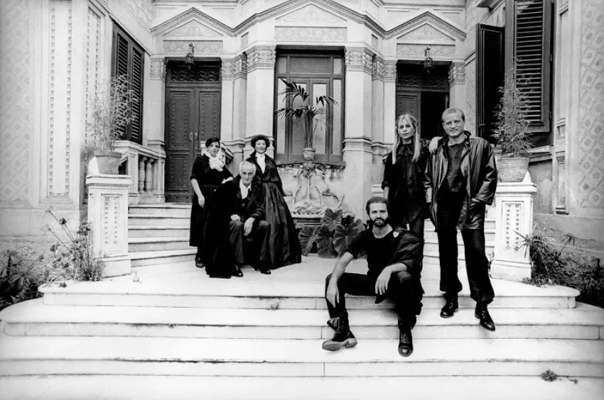
VERSACE
Family photo
1976
Versace dress

